Slide 1


Session 3
Python Syntax - 1
OPERATOR IN PYTHON

Slide 2
Learning Outcomes
len() function
Built-in list methods
Mutable vs Immutable data types
Operators in Python
Arithmetic Operator
Assignment Operator
Logical Operator
Bitwise Operator
Operator Precedence

Slide 3
len() function
len() function is a built-in Python method that returns to us the length/count of the number of elements in a collection datatype(lists, strings, dictionary, etc.) The len() when called on a nested multi-dimensional list only the number of elements in the first dimension is returned.
my_list = [1,2,3] print(my_list) print(len(my_list))
[1, 2, 3] Output : 3
my_list = ['A string',23,100.232,'o'] print(my_list) print(len(my_list))
['A string', 23, 100.232, 'o'] Output : 4
my_list = [[1,2,3],[4,5,6],[7,8,9]] print(my_list)
print(len(my_list))
[[1, 2, 3], [4, 5, 6], [7, 8, 9]] Output : 3

Slide 4
Built -in List methods
All datatypes including list are an object in Python. This means we can call methods on the objects created using these classes. Try creating a list then write the list name followed by a . and press the tab key
my_list = [11,22,33,44,55,66,77,88,99] my_list.
This gives us a dropdown of all the available built-in list methods we will be looking at a few important ones. The methods can be :
In place (affects the actual list)
not in place (the actual list is not affected)
The append() method adds an element to the end of the list The append() method is an inplace method.
my_list = [11,22,33,44,55,66,77,88,99] my_list.append(101)
my_list Output : [11, 22, 33, 44, 55, 66, 77, 88, 99, 101]
The insert() method adds an element at the specified index The append() method is an inplace method.
my_list = [11,22,33,44,55,66,77,88,99] my_list.insert(4,"I am added before index 4") print(my_list)
[11, 22, 33, 44, 'I am added before index 4', 55, 66, 77, 88, 99]

Slide 5
Mutable and Immutable data types
All the collection datatypes in Python can be classified into 2 types.
mutable (Individual elements can be reassigned)
immutable (Individual elements cannot be reassigned)
Lists are mutable
Strings are immutable
my_list = [11,22,33,44,55,66] print(my_list) my_list[3] = 99 print(my_list)
[11, 22, 33, 44, 55, 66] [11, 22, 33, 99, 55, 66]
my_string = "hello" print(my_string) my_string[3] = 'r' print(my_string)
hello
It will throw an error."'str' object does not support item assignment"

Slide 6
input() function
Input function allows Python to take in input from users While taking inputs we have an option to prompt the user.
NOTE: Functions will always have open and close brackets
input("enter a number : ")
enter a number: 1000
'1000'
The above line of code does not make sense as we are taking input from the user and not storing it anywhere
To store data we need to use variables

Slide 7
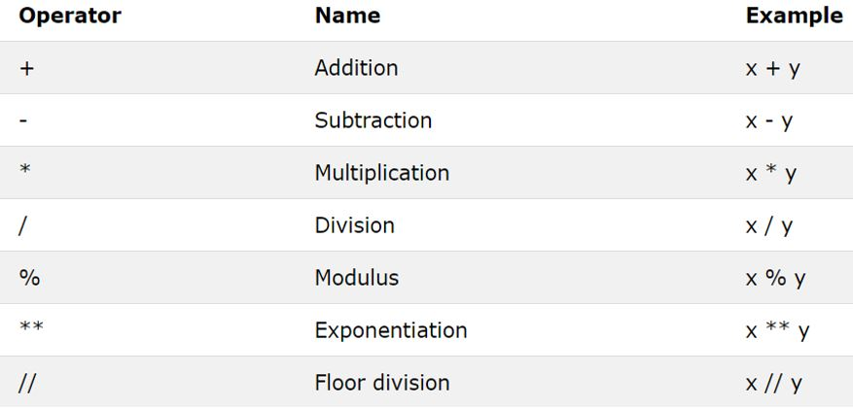
Operators in Python
Arithmetic Operator
Assignment Operator
Logical Operator
Bitwise Operator
Operator Precedence
1. Arithmetic Operators

Slide 8
Addition, Multiplication, subtraction, and division are the standard operations.
The Modulus (%) operator gives us the remainder of a division operation
a = 10 b = 2 print(a%b) Output : 0
a = 10 b = 3 print(a%b) Output : 1
The Exponential (**) operator gives us the x raised to y output of 2 numbers (x^y)
a = 8 b = 2 print(a**b) Output : 64
The floor division (//) operator is used to return the quotient of a division operator without the decimal places
a = 8 b = 2 print(a//b) Output : 4

Slide 9
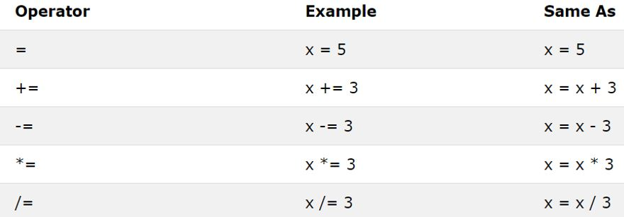
2. Assignment Operators

Slide 10
The = sign is used to assign a data type to a variable
a = 10 print(a)
10
a += 10 print(a)
20
The above line of code is similar to a = a + 10
a = a + 10 print(a)
30
The same logic applies to all the assignment operators

Slide 11
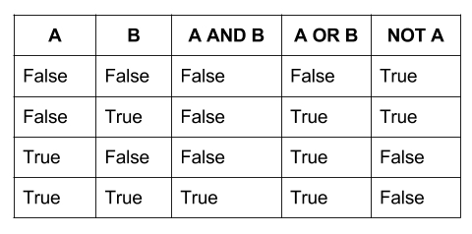
3. Logical Operators
and
or
not
Gives the output depending on the truth table or logic table

Slide 12
We can try to emulate the truth table above by doing the same operations
True and True
True
False and True
False
False or True
True
not True
False
However, the logical operators are never used to directly operate on Boolean values. Instead, we generate these Boolean values from comparison operators most of the time
not b>=a
False
not True
False

Slide 13
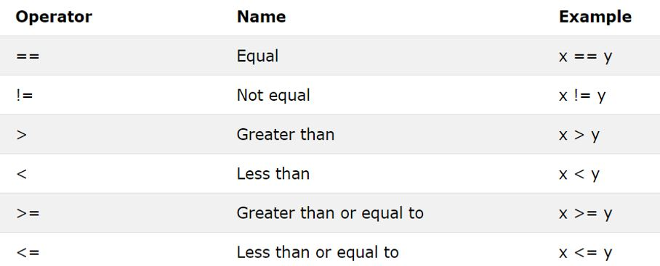
4. Comparison Operator

Slide 14
The comparison operator generates Boolean output depending on whether the condition being checked
a = 10 b = 20 c = 10 print(a==b) print(a==c) print(a!=b)
False True True
a = 10 b = 10 print(a<b) print(a<=b)
False
True

Slide 15
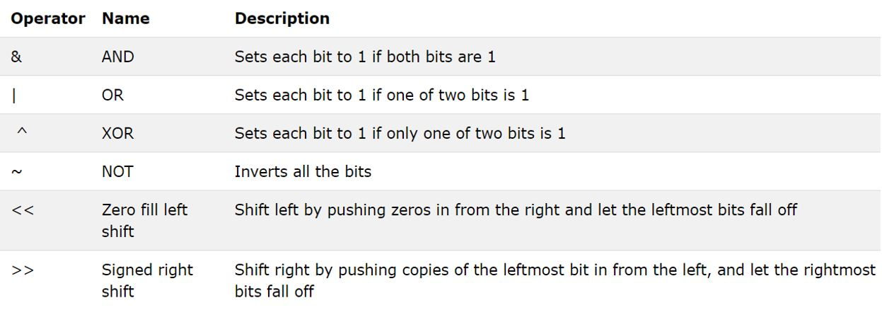
5. Bitwise operators

Slide 16
Bitwise operators are also like logical operators they give output based on the truth table. But instead of acting directly on the Boolean datatype, they return results by operating on the Bit representation of the integer, float, or string datatype.
True is considered as the bit 1
False is considered as the bit 0
a = 5 #0101 - Bitwise representation of integer 5 b = 10 #1010 - Bitwise representation of integer 10 a&b #0000 - Bitwise and(&) of bit representation of 5 and 10 flowing the truth table
0
a = 5 #0101 - Bitwise representation of integer 5 b = 10 #1010 - Bitwise representation of integer 10 a|b #1111 - Bitwise or(|) of bit representation of 5 and 10 flowing the truth table
15
a = 5 #0101 - Bitwise representation of integer 5 a = ~5
We might expect the output of a = ~5 to be 10
a = 5 #0101 a = ~5 #1010 - Bitwise not(~) of bit representation of 5

Slide 17
HOMEWORK SOLUTION
#TASK 1
1) create a basic calculator
Take 2 numbers from the user (using input statement)
Print out the remainder of 2 numbers
num1 =input("Enter first no : ") num2 = input("Enter second no : ") print(num1%num2) print(num1/num2)
Enter first no:10 Enter second no : 3 1
0.33333

Slide 18
#TASK 3 3<10 or 4<9 or 5>=9 and False
#TASK 4 Print the length of every item in the below list my_list = ["ON", "My", "own", "technology"]
#TASK 5 Remove decimal places from the given integers x = 12.14 y = 2000.188888
#TASK 6 Find if the number 24563 is divisible by 16 or not
#TASK 7 Create a tuple and a slice object. Start the slice object at position 3, and slice to position 5.

Slide 19
THANK - YOU

